Slide 2
An Empirical Complexity Analysis Of Candidate-Narrowing Strategies For Incremental LLM-Driven Graph Construction
Adrian Luke A. Labasan
Alejandrei Jazz F. Lopez
Geila May C. Rigayen
Melvie Jeanna O. Abad

Slide 3
Chapter I
INTRODUCTION

Slide 4
BACKGROUND OF THE STUDY
What is a knowledge graph?
A graph is made of nodes (concepts) connected by edges (relationships).
A knowledge graph uses this to show how ideas relate, e.g., Calculus requires Limits.
Used in web search, recommendation systems, and education.
How are they built today?
Before: domain experts built them by hand. Accurate, but it doesn’t scale.
Now: Large Language Models (LLMs) can read text and extract concepts and relationships automatically.

Slide 5

The problem: knowledge keeps growing
Most systems build the graph once, in a single batch.
But new concepts keep appearing (a new course topic, a new technique).
Rebuilding the whole graph for one new concept is wasteful.
This is the incremental insertion problem: How do we connect one new concept to an existing graph without re-checking every node?

Slide 6
Why brute force doesn’t work
Asking an LLM to compare the new concept against every existing node needs “a huge number of queries” [1].
Funk et al. [1] reported 22–50 LLM prompts per concept, costing $0.11–$12.45, and this grows as the graph grows.

Slide 7

The solution: candidate narrowing
Step 1: use a cheap method (e.g., embeddings) to shortlist likely candidates.
Step 2: use the LLM only on that shortlist.
Existing approaches:
  iText2KG [2]: cosine-similarity threshold (~0.6)
  SAC-KG [3]: learned pruning, tested at over 1 million nodes
  EraRAG [4]: size-bounded “buckets,” with a proof that insertion cost shouldn’t grow with graph size

Slide 8

The research gaps
Gap 1: No study measures insertion cost as a function of graph size. Costs are reported only in aggregate.
Gap 2: No study compares narrowing strategies against each other under the same task and measurements.

Slide 9
STATEMENT OF THE PROBLEM
How can a new concept be added to an LLM-built knowledge graph without checking every existing node?
RQ1: How do time and LLM calls per insertion change as the graph grows?
RQ2: Does placement accuracy hold up as the graph grows?
RQ3: How do the four strategies compare under identical conditions?
RQ4: Does the cost of a single insertion stay flat under a bucket-capped strategy?

Slide 10
OBJECTIVES OF THE STUDY
General: Characterize and compare the cost and accuracy of narrowing strategies as the graph grows.
Specific:
Implement 4 strategies:
brute-force LLM comparison
embedding-similarity thresholding
approximate nearest-neighbor (ANN) retrieval
bounded-bucket partitioning
2. Run insertions on graphs from 50 to 2,000 nodes
3. Measure time, LLM calls, and accuracy
4. Test whether bucket-capped cost stays flat
5. Release a reproducible codebase and dataset

Slide 11
SIGNIFICANCE OF THE STUDY
To the field of Computer Science | Provides an empirical benchmark by comparing multiple insertion strategies under identical conditions across different graph sizes, addressing gaps in existing literature.
To Future Researchers | Empirically validates theoretical cost claims and provides a foundation for evaluating new strategies, domains, and performance limits.
To Practitioners Building Knowledge-Graph Systems | Helps developers choose the most appropriate narrowing strategy for their expected graph size and update frequency.

Slide 12
SCOPE OF THE STUDY
Focus: Only the incremental insertion phase, which is adding one new node to an already-existing graph. It does not propose a new batch-construction method.
Strategies covered: brute force, embedding threshold, ANN, bounded bucket
Data sources: Gold-standard data: Metacademy (141 concepts) and DSA (29 concepts) for accuracy and Synthetic data: up to ~2,000 nodes for cost scaling
Measures: Wall-clock time per insertion, LLM calls per insertion, and placement accuracy (precision, recall, F1).

Slide 13
LIMITATIONS OF THE STUDY
Bare concept names only; one model, one fixed prompt
Synthetic concepts are unverified (cost only, no accuracy)
Fixed parameters; no thresholds stricter than 0.6 tested
Single insertions only; amortized cost not tested
One run per configuration, 10 trials per size; no hypothesis tests
Accuracy measured at only two graph sizes
Ranking framework defined post hoc

Slide 14
Chapter II
REVIEW OF RELATED LITERATURE

Slide 15
Related System / Concept | Key Idea | Relevance to the Study
Funk et al.’s ontology construction (KRIS-based) [1]; brute-force comparison | Comparing a new concept against every node needs too many LLM calls. | Serves as the control condition. Its 22 to 50 prompts per concept is the cost benchmark.
iText2KG, cosine-similarity threshold [2] | Keep only nodes whose similarity passes a cutoff. | Basis for Strategy B and the fixed θ = 0.6. Its threshold problem motivates a count-based alternative.
HNSW [10] and FAISS [11]; top-k retrieval | Retrieve a fixed number of the most similar nodes. | Basis for Strategy C. It selects candidates without a similarity cutoff.
EraRAG, size-bounded buckets, Theorem 4 [4] | Group nodes into capped buckets so an insertion touches only one. | Basis for Strategy D. It is also the claim whose premise the study tests.
SAC-KG (Generator, Verifier, Pruner) [3] | Automated construction works at over one million nodes. | Makes a 2,000-node sweep realistic. Cost against graph size is still unreported.

Slide 16
Related System / Concept | Key Idea | Relevance to the Study
ACE and the Metacademy and DSA gold graphs [6], [7] | Expert-verified graphs give a true answer to check against. | Provide the ground truth for measuring placement accuracy.
Pareto dominance, weighted-sum model, TOPSIS, minimum-level gates [13]–[21] | Judge strategies on cost and accuracy together, not one alone. | Support how strategies are judged: gates, then dominance, then weighted ranking.
Amortized complexity analysis | Cost is averaged over a sequence of operations. | Single-insertion tests cannot confirm an amortized bound, so the study tests the premise only.
EraRAG’s batch-size experiments [4] | Prior tests varied incoming batch size, not graph size. | The study varies graph size, which fills that gap.
EKG-Dataset [7]; Balilo [8]; Naguio and Roxas [9] | Public data exists, and local work on insertion does not. | The datasets make the artifact reproducible. No local study covers incremental insertion, which supports novelty.

Slide 17
Conceptual Framework
INPUT
Existing graph of size n (50 to 2,000 nodes)
One new concept to insert
Narrowing strategy: A brute force, B embedding threshold, C ANN retrieval, D bounded bucket
PROCESS
Narrowing strategy reduces the graph to a candidate shortlist
Shared LLM decision step judges the relationship for each shortlisted candidate
Graph update and measurement
OUTPUT
Updated graph of size n + 1
Cost: wall-clock time and LLM calls per insertion
Accuracy: precision, recall, F1 against the gold standard

Slide 18
Chapter III
RESEARCH METHODOLOGY

Slide 19
Research Design
Developmental, experimental design
Works like an algorithm benchmark: no human respondents, no surveys
Independent variables: narrowing strategy and graph size
Dependent variables: insertion cost (time, LLM calls) and placement accuracy

Slide 20
Data Sources
Gold-standard data (accuracy)
Metacademy: 141 concepts
DSA: 29 concepts
Expert-verified prerequisite relationships
Withhold one concept, re-insert it, compare against the true answers
Synthetic data (cost only)
Pool of 2,254 unique computer science concept names, generated with an LLM
Used for graph sizes from 50 to 2,000 nodes
Not verified, so it is never used for accuracy claims

Slide 21
Experimental Design
Input: one new concept and an existing graph
Narrowing step (differs per strategy): produces a shortlist of candidates
Decision step (identical for all): an LLM judges the new concept against each shortlisted candidate
Only the narrowing step changes, so any difference in results comes from the narrowing method

Slide 22
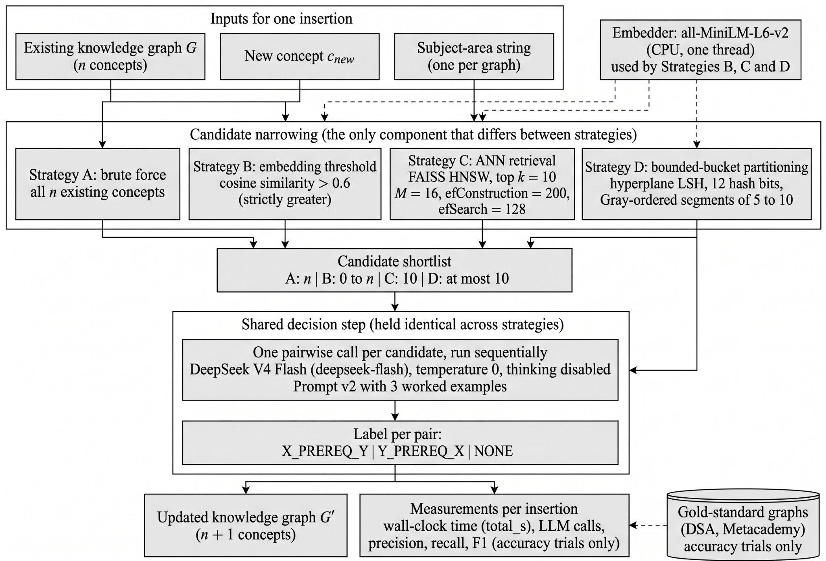
Research Design

Slide 23
The Four Strategies
Strategy | How it builds the shortlist | Max LLM calls per insertion
S1 Brute force | Every existing node (control) | n
S2 Embedding threshold | Nodes with cosine similarity above 0.6 | Up to n
S3 ANN retrieval | Top 10 most similar nodes (FAISS HNSW index) | 10
S4 Bounded bucket | Only the members of the new concept's bucket (5 to 10 nodes) | 10

Slide 24
The Shared Decision Step
One LLM call per shortlisted candidate, run one at a time
Model: DeepSeek V3, temperature 0, one fixed prompt
Input: concept names only, plus a subject-area label
Output: X is a prerequisite of Y, Y is a prerequisite of X, or none
Pilot (brute force on DSA): micro F1 0.541, recall 0.611, a conditional pass
Prompt was kept unchanged and not tuned further

Slide 25
Experimental Procedure
Graph sizes: 50, 100, 200, 500, 1,000, 2,000
One single insertion per trial, 10 trials per size
Accuracy runs: 59 trials (29 DSA and 30 Metacademy)
Parameters were fixed before running and not tuned on the data
8 one-at-a-time sensitivity settings:
  S2: threshold 0.4 and 0.5
  S3: k = 5 and 20, efSearch = 64 and 256
  S4: bucket bounds (2, 5) and (10, 20)
12 configurations in total, one run each

Slide 26
Measures and Analysis
Cost: wall-clock time per insertion and LLM calls per insertion
Accuracy: precision, recall, F1 (micro-averaged)
Shortlist recall: the share of true neighbors that narrowing keeps
Scaling: slope of log(cost) against log(n)
  below 0.1: approximately flat
  0.1 to 0.9: sub-linear
  above 0.9: approximately linear
Results are described with 95% bootstrap intervals; no hypothesis tests

Slide 27
Decision and Ranking Framework (Post Hoc)
Defined after the Chapter 4 measurements were available, and labelled as such
Three gates:
  G1: shortlist recall beats a random shortlist
  G2: at most 50 LLM calls per insertion at n = 2,000
  G3: not beaten on both calls and F1 by another strategy
Classes: Effective, Conditionally effective, Not effective
Ranking: weighted score of F1 and log(calls) under three weight scenarios, plus a 20,000-draw weight sweep and a TOPSIS cross-check

Slide 28
Chapter IV
RESULTS AND DISCUSSIONS (INITIAL RESULT)

Slide 29
DATA COLLECTED
24 runs, 12 configurations, 3 data sources
24
12
59 / 60
24 / 24
runs: 12 accuracy-mode and 12 size-sweep
configurations: 4 primary and 8 sensitivity
trials per accuracy / sweep run
runs passed the validation gate
DSA gold graph
Metacademy gold graph
Synthetic concept pool
29 expert-verified concepts. Used for accuracy (29 leave-one-out trials).
141 expert-verified concepts. Used for accuracy (30 trials).
2,254 unique names, no ground truth. Used for cost at n = 50 to 2,000 (10 trials per size).

Slide 30
SETUP
The four strategies compared
Strategy | Shortlist rule | Max calls per insertion
S1 Brute force | Every existing node | n
S2 Threshold | Cosine similarity above θ = 0.6 | Up to n (uncapped)
S3 ANN retrieval | Top k = 10 (FAISS HNSW) | 10
S4 Bounded bucket | LSH segment, (s_min, s_max) = (5, 10) | 10
Every strategy uses the same decision step (DeepSeek V4 Flash, temperature 0, one call per candidate), so differences come from the narrowing mechanism. Results are means with 95% bootstrap intervals, with no hypothesis tests.

Slide 31
RQ1: How do time and LLM calls per insertion change as the graph grows?
Wall-clock time per insertion at n = 2,000
1,713 s
0.94 s
8.28 s
5.64 s
S1 Brute force. Slope 0.96, approximately linear.
S2 θ = 0.6. Weak fit (R² 0.46): most trials make no call.
S3 ANN, k = 10. Slope −0.02, approximately flat.
S4 Bucket (5, 10). Slope 0.008, approximately flat.
So what
Time follows calls: about 0.8 to 0.9 s per LLM call, and the shortlist step takes under 0.03 s.
At n = 2,000, brute force is about 207 times slower than S3 and 304 times slower than S4.
Answer to RQ1: linear for brute force, flat for the capped strategies, call-dependent for the threshold.

Slide 32
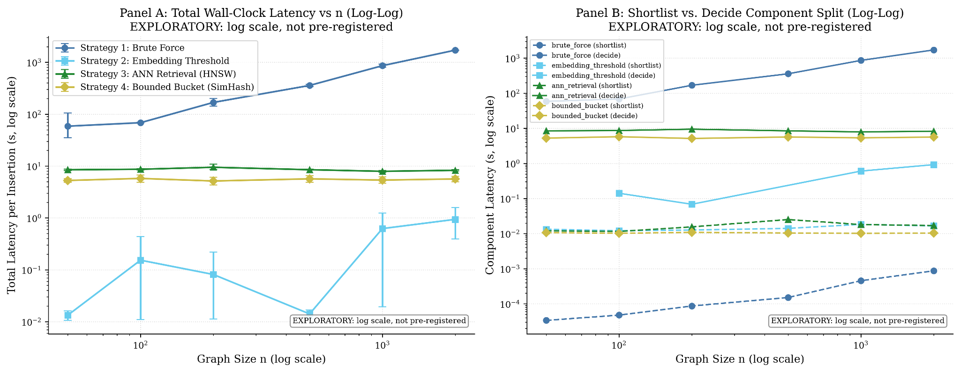

Slide 33
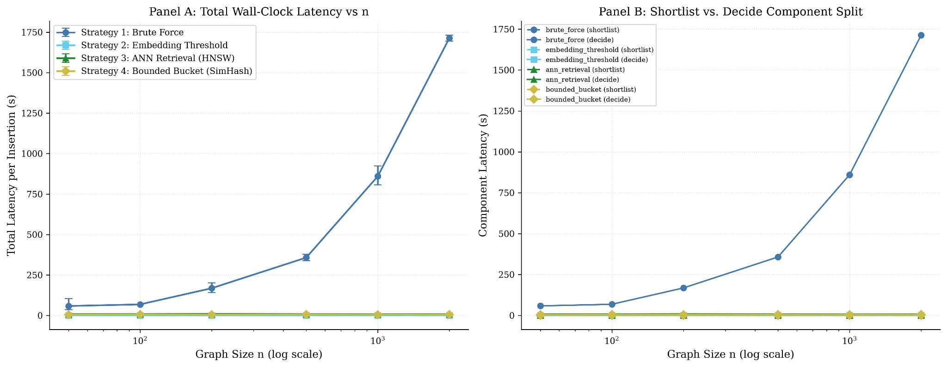

Slide 34
RQ1: How do time and LLM calls per insertion change as the graph grows?
LLM calls per insertion by graph size
Strategy | n = 50 | 100 | 200 | 500 | 1000 | 2000 | Log-log slope
S1 Brute force | 50 | 100 | 200 | 500 | 1000 | 2000 | 1.0000
S2 θ = 0.6 | 0.0 | 0.1 | 0.1 | 0.0 | 0.7 | 0.8 | undefined
S3 ANN, k = 10 | 10 | 10 | 10 | 10 | 10 | 10 | 0
S4 Bucket (5, 10) | 6.6 | 7.5 | 7.1 | 7.1 | 6.8 | 7.0 | −0.0004
So what
S1 needs n calls per insertion, the linear cost that [1] warned about.
S3 and S4 stay flat because their shortlists are capped at 10 candidates.
S2 grows with the nodes above θ, from a small base: 13.5 calls at θ = 0.4 and n = 2,000.

Slide 35
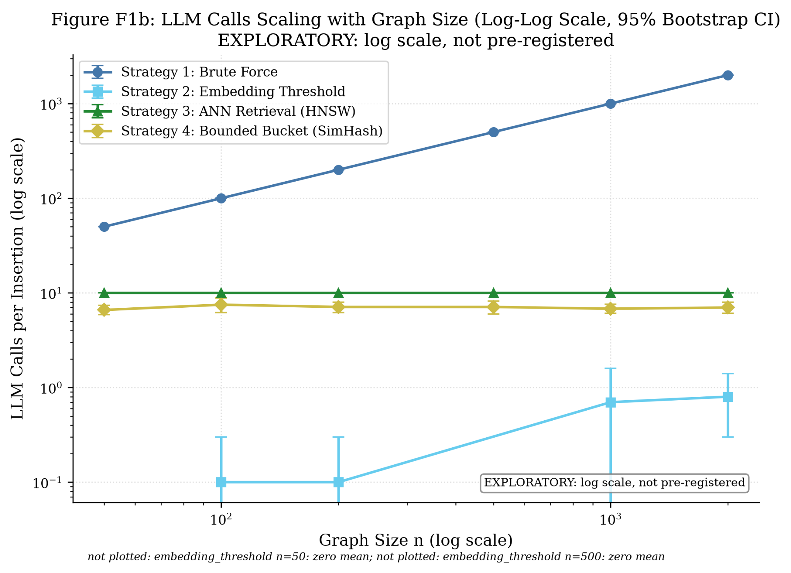

Slide 36
RQ2: Does placement accuracy hold up as the graph grows?
Accuracy of the primary configurations
Corpus | Strategy | Calls | Precision | Recall | F1 | Shortlist recall
DSA | S1 Brute force | 28.0 | 0.548 | 0.630 | 0.586 | 1.000
DSA | S2 θ = 0.6 | 0.76 | 0.643 | 0.083 | 0.148 | 0.111
DSA | S3 k = 10 | 10.0 | 0.639 | 0.426 | 0.511 | 0.528
DSA | S4 (5, 10) | 6.97 | 0.594 | 0.176 | 0.271 | 0.259
Metacademy | S1 Brute force | 140.0 | 0.081 | 0.624 | 0.143 | 1.000
Metacademy | S2 θ = 0.6 | 1.13 | 0.594 | 0.174 | 0.270 | 0.202
Metacademy | S3 k = 10 | 10.0 | 0.245 | 0.367 | 0.294 | 0.505
Metacademy | S4 (5, 10) | 7.37 | 0.149 | 0.092 | 0.114 | 0.147
The best F1 changes with the corpus: S1 on DSA (0.586), S3 on Metacademy (0.294). Micro-averaged, one run each.

Slide 37
RQ2: Does placement accuracy hold up as the graph grows?
Why accuracy differs across strategies
Brute force over-links
Narrowing trades recall for precision
The decision step caps recall
Recall is steady (0.630 and 0.624), but precision falls from 0.548 to 0.081 when 140 candidates are judged one by one.
Recall never exceeds shortlist recall, and the decision step labels only 62% to 86% of shortlisted true neighbours correctly.
S2 has precision of 0.643 and 0.594 but recall of only 0.083 and 0.174, because at θ = 0.6 most concepts reach no decision.
So what
F1 is lower on Metacademy than on DSA for S1, S3 and S4 (S3: 0.511 to 0.294), but domain and edge density differ too, so size alone cannot be blamed. The recall-precision trade-off of narrowing echoes the one reported for embeddings and LLMs in [6].

Slide 38
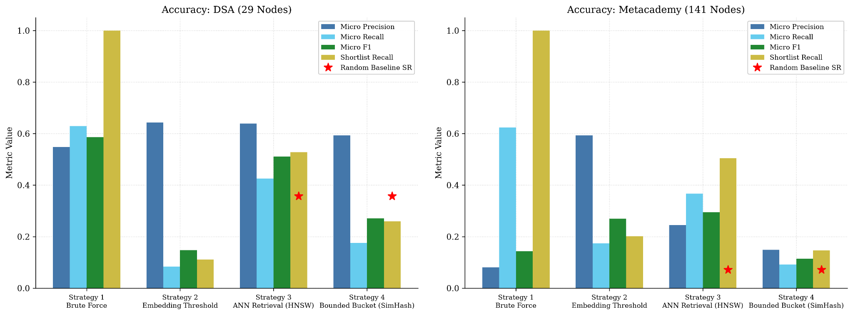

Slide 39
RQ2: Does placement accuracy hold up as the graph grows?
Looser settings help only on DSA
Setting | DSA F1 | Meta F1 | Calls (DSA / Meta)
S2 θ = 0.4 | 0.269 | 0.295 | 2.2 / 7.1
S2 θ = 0.5 | 0.191 | 0.311 | 1.2 / 2.9
S2 θ = 0.6 (primary) | 0.148 | 0.270 | 0.8 / 1.1
S3 k = 5 | 0.374 | 0.368 | 5 / 5
S3 k = 10 (primary) | 0.511 | 0.294 | 10 / 10
S3 k = 20 | 0.569 | 0.266 | 20 / 20
S4 (2, 5) | 0.102 | 0.100 | 3.1 / 3.3
S4 (5, 10) (primary) | 0.271 | 0.114 | 7.0 / 7.4
S4 (10, 20) | 0.486 | 0.148 | 14.2 / 15.9

Slide 40
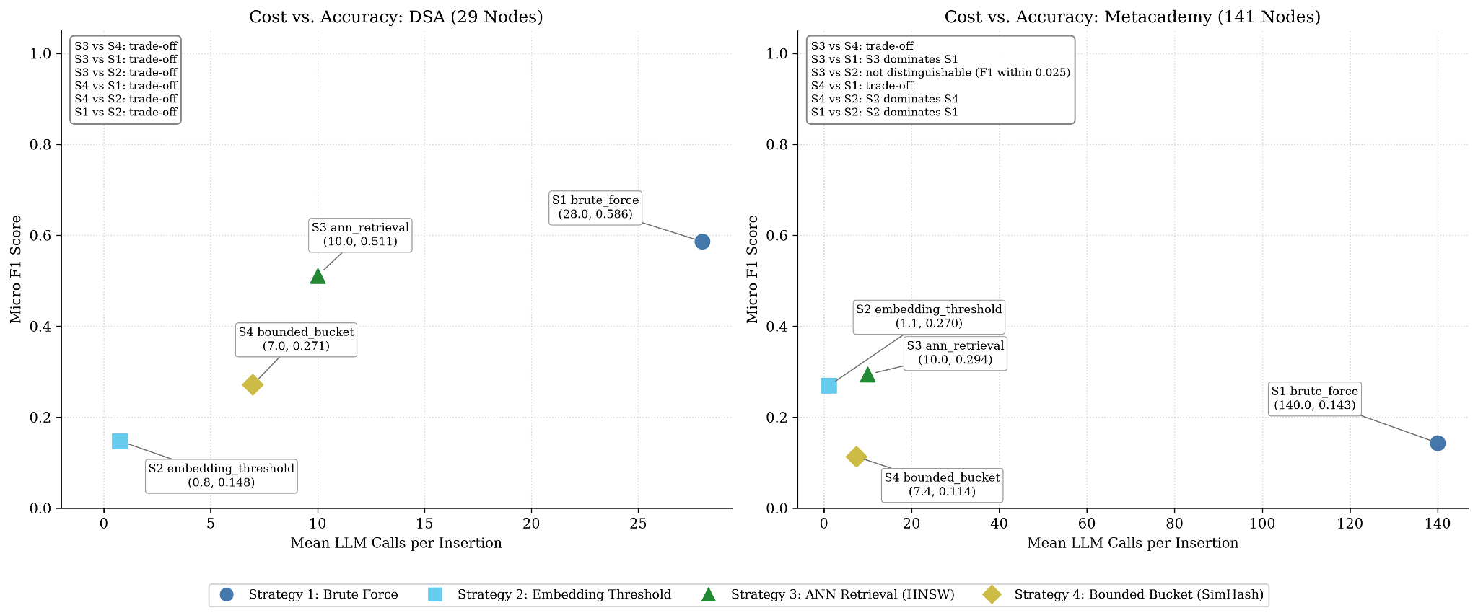

Slide 41
RQ3: How do the four strategies compare under identical conditions?
Trade-offs on DSA, domination on Metacademy
DSA (29 concepts)
Metacademy (141 concepts)
Every pair of strategies is a trade-off.
Best F1 is S1 (0.586), at 28 calls.
S1 gains only +0.075 F1 over S3 for 18 more calls.
S3 dominates S1: F1 +0.151 with 130 fewer calls.
S2 dominates both S1 and S4.
S3 vs S2: ΔF1 = 0.0246, inside the 0.025 margin, so not distinguishable.
So what
S2’s low call count is a recall cost, not a free saving: most insertions find no candidate above θ, so shortlist recall is only 0.111 and 0.202. The largest graph reverses the DSA picture, because brute force is dominated outright.

Slide 43
RQ3: How do the four strategies compare under identical conditions?
Only S3 passes every gate
Strategy | G1: beats random | G2: 50 calls or fewer | G3: not dominated | Class
S1 Brute force | Not applicable | Fail (2,000) | Fail on Metacademy | Not effective
S2 θ = 0.6 | Not assessable | Pass (0.8) | Pass | Conditionally effective
S3 k = 10 | Pass | Pass (10) | Pass | Effective
S4 (5, 10) | Fail on DSA | Pass (7.0) | Fail on Metacademy | Not effective
Post hoc and single-run. No strategy meets the pilot’s absolute bar (F1 at least 0.50, recall at least 0.70), so S3 is best in a relative sense only.

Slide 44
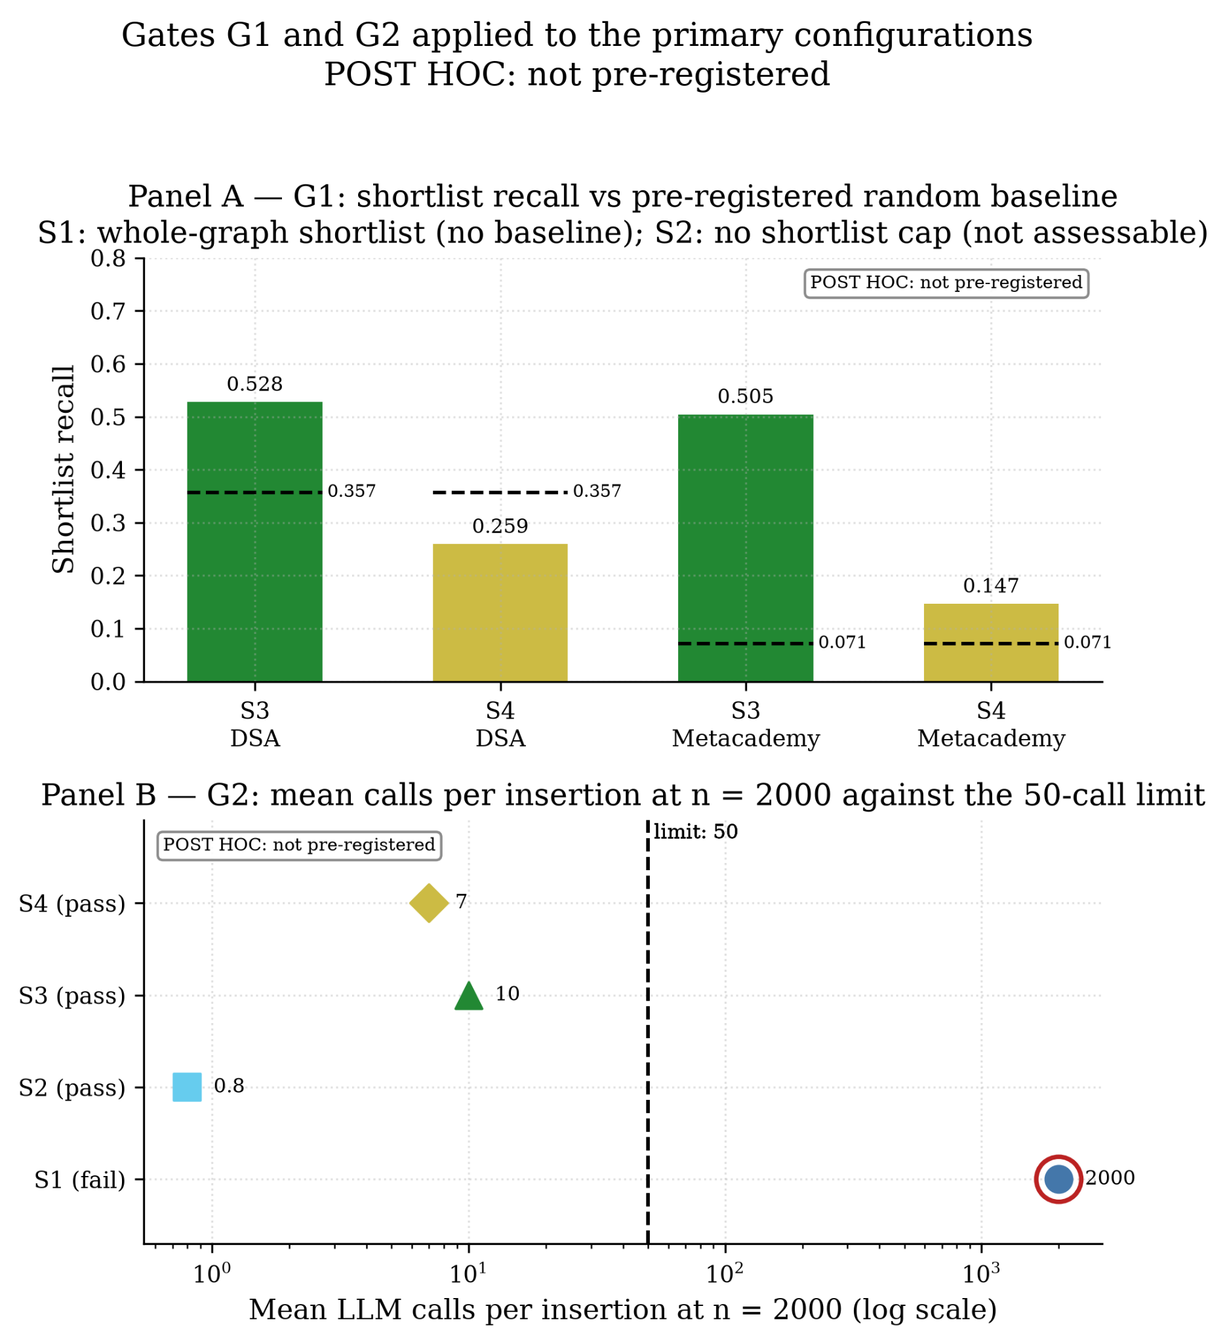

Slide 45
RQ3: How do the four strategies compare under identical conditions?
S3 is the most stable across weights
``````````````````````````````````````
DSA: the leader changes
Metacademy: S2 leads
20,000 weight draws
Accuracy-first: S1 (0.700)
Balanced: S3 (0.587)
Cost-first: S2 (0.700)
S2 scores 0.905 to 0.959 in all scenarios.
S3 is second (0.726 to 0.883).
S2 gains on cost what it lacks in recall.
S3 is last in under 0.5% of draws.
S3 is second most often: 60% (DSA), 68% (Metacademy).
S4 is first in no draw.
So what
A single weighted ranking would support different conclusions depending on the weights. These scores are post hoc, single-run and based on min-max scaling over four strategies, so they describe these measurements, not repeated-run differences.

Slide 46
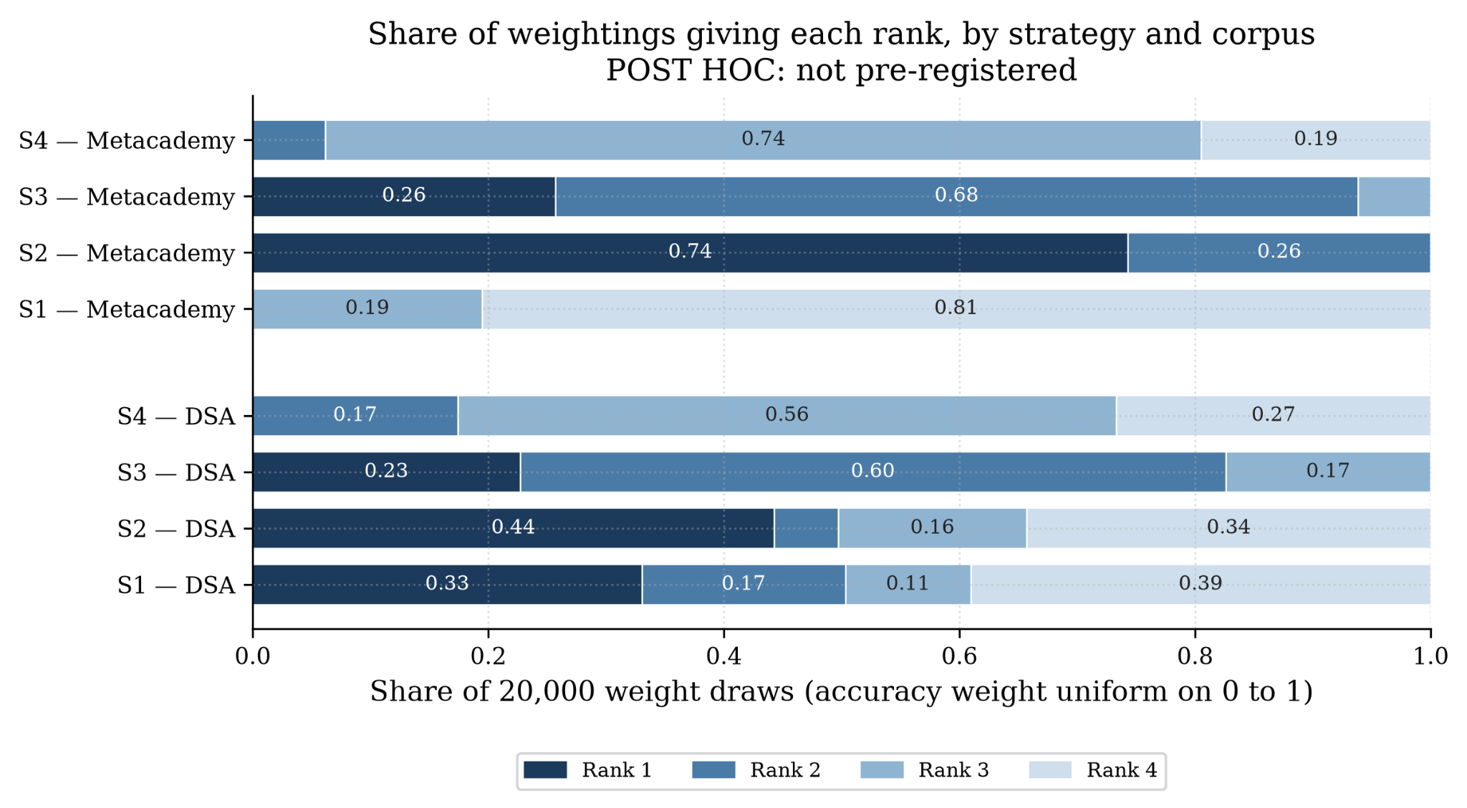

Slide 47
RQ4: Does the cost of a single insertion stay flat under a bucket-capped strategy?
Bucket cost does not grow with graph size
6.6–7.5
5.15–5.77 s
≈ 0
mean LLM calls per insertion, against a cap of 10 (n = 50 to 2,000)
mean time per insertion; the shortlist step takes about 0.01 s
log-log slopes: calls −0.0004, time 0.0084; intervals contain zero
So what
Consistent with the premise behind the amortised bound in [4]: an insertion touches a bounded region of the graph.
Flat calls are close to guaranteed by the cap, and S3 is equally flat, so flatness is not specific to bucket partitioning.
These are single un-amortised insertions; the amortised bound itself is not tested.

Slide 48
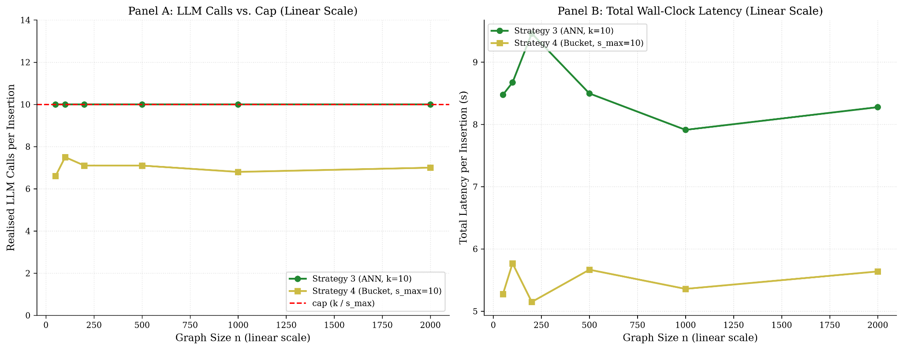

Slide 49
LIMITS OF THESE RESULTS
What the results do not show
One run per configuration and 10 trials per size, so no hypothesis tests.
One decision model, one prompt and bare concept names.
Accuracy at only two sizes (29 and 141 concepts) that also differ in domain and density.
The synthetic concept pool is unverified and used for cost only.
Single un-amortised insertions; the amortised bound of [4] is untested.
Gates and weights were set post hoc, so classes label these measurements only.

Slide 50
SUMMARY
Summary of findings
Research question | Finding
RQ1 Cost vs n | Brute force grows linearly (1,713 s at n = 2,000). ANN and bounded buckets stay flat. The threshold grows with passing nodes, from a small base.
RQ2 Accuracy vs n | F1 is lower on the 141-node graph for S1, S3 and S4, but domain and density are confounded. Brute force over-links (precision 0.081).
RQ3 Comparison | Only S3 (ANN) is effective; S2 is conditionally effective; S1 and S4 are not. No strategy meets the pilot’s absolute accuracy bar.
RQ4 Bucket premise | Calls and time did not grow with n, consistent with the premise. The amortised bound is untested.

Slide 51
Thank you!

Slide 52
ccis@mmsu.edu.ph
CCIS Building, #16S Quiling Sur,
City of Batac, Ilocos Norte, Philippines
MMSU – College of Computing and Information Sciences
www.ccis.mmsu.edu.ph

